Slide 1
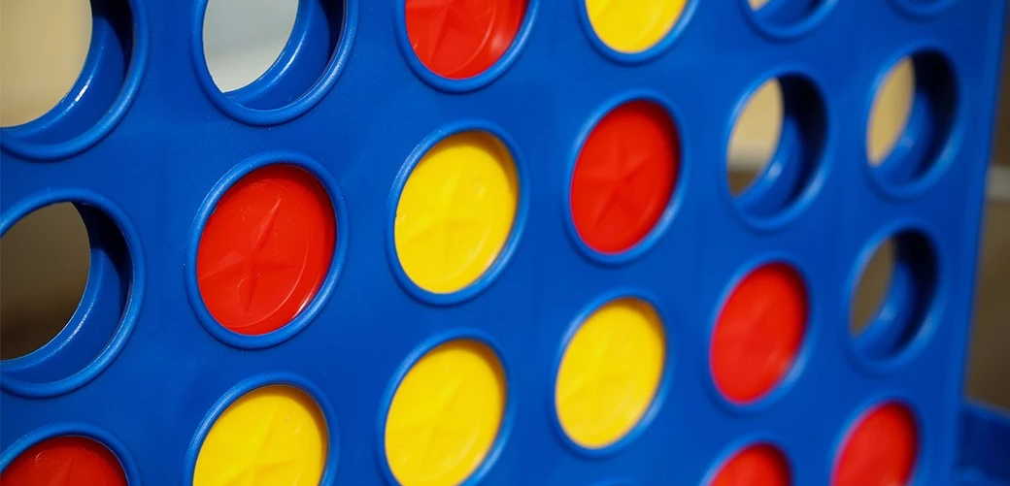

Connect-4-Game (by FAM)
Mohammad El Kadri
Faysal Minawi
Ali Mousawi
Firas Noun
Software Construction
Prof. Rida Assaf

Slide 2
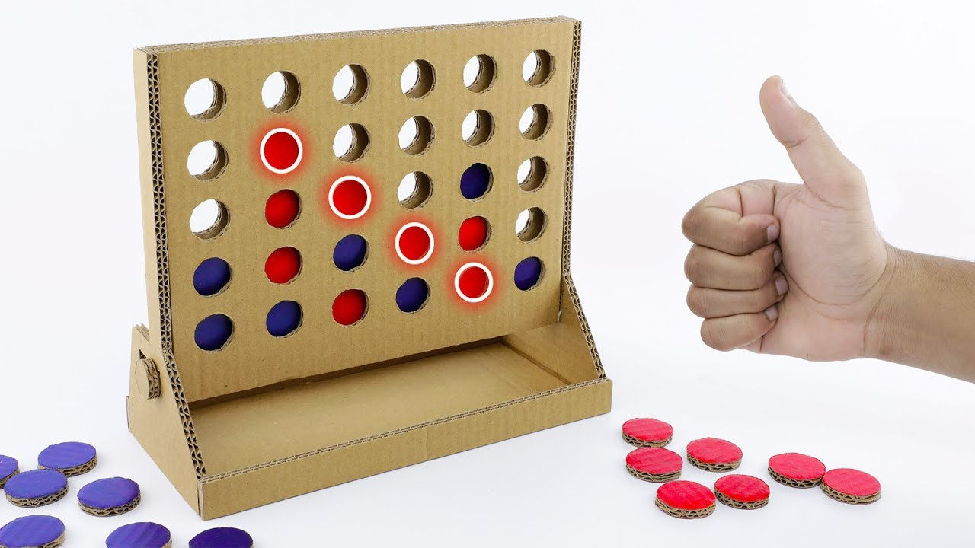
Description
How the game works:
Connect four “1s” or “2s” either horizontally, vertically, or diagonally
Modes:
Single Player (vs computer)
Multiplayer
Single Player Levels:
Beginner, Easy, Medium, Hard
Starting player randomly assigned

Slide 3
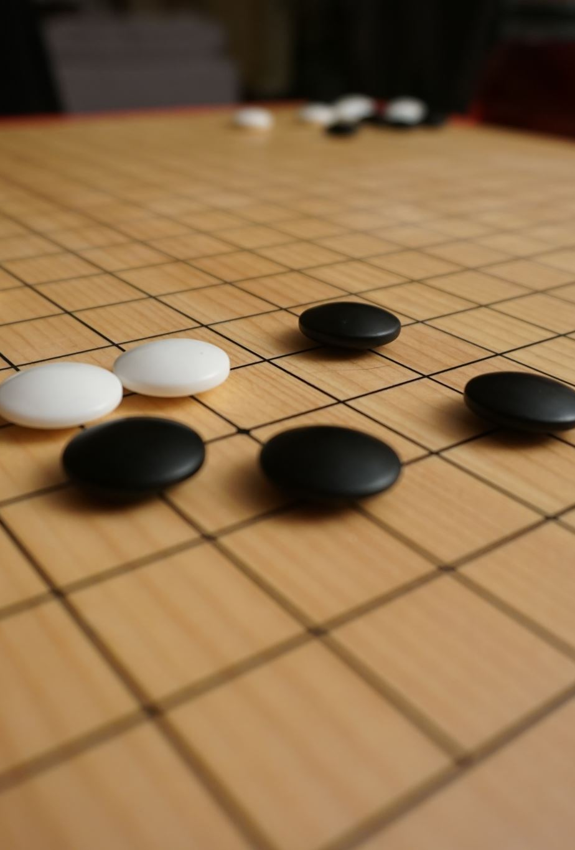
Implementation (Functions Used)
Random_move: used to play against beginner bot
Player_move: updates the board (when possible) according to the move given by the player
Check_winner: helper function to check whether there are any four connected 1’s or 2’s
Check_win_or_tie: uses check_winner and returns a boolean whether there is a winner or not. If yes, it also prints the winner.
Check_win_or_tie_single: returns the winner in single player mode

Slide 4
Functions Continued
Is_column_full: returns a Boolean after checking if a column is full
Update_board: updates the board after each move
Best_move: identifies the best move to be done using the minimax algorithm. The latter has a depth; the more it is the harder the game.
Scoring: Helper function for minimax
calcRow: Helper function for minimax to calculate rows

Slide 5
Functions Continued
MinMax_Recur: helper function to the best move function. It includes the minimax algorithm.
Display_board: used to display the board that is constantly updated after each move by the user or the bot.
Main: runs the game. A sample explanation is in the following slides. The game either ends in a win or in a tie.

Slide 6
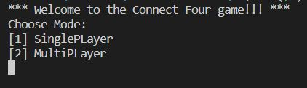
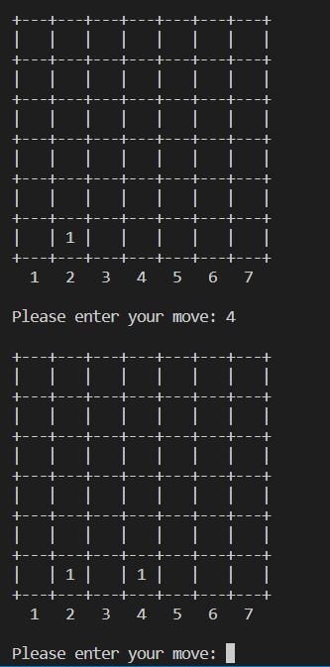
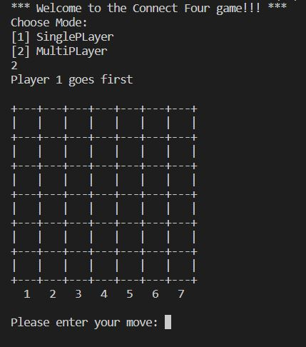
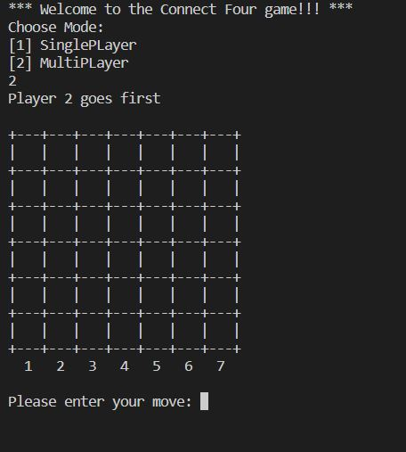
Multiplayer
First player inserted in column 2, the second in column 4, and the game continues…
Choose whether to play against the computer or multiplayer
First player randomly assigned

Slide 7
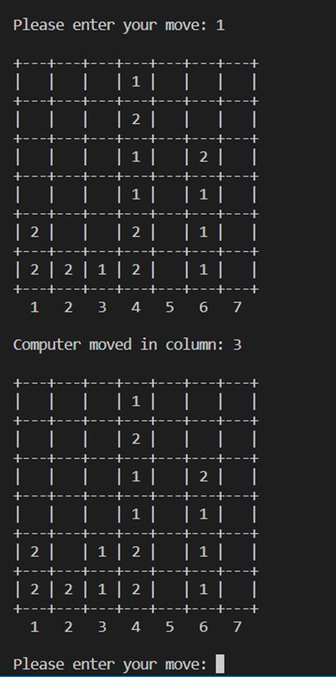
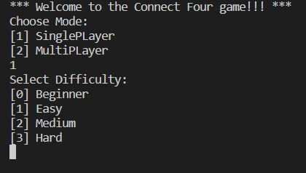
Single Player (Beginner)
Choosing option 1 above displays the following:
The game’s board after certain moves in the beginner mode

Slide 8
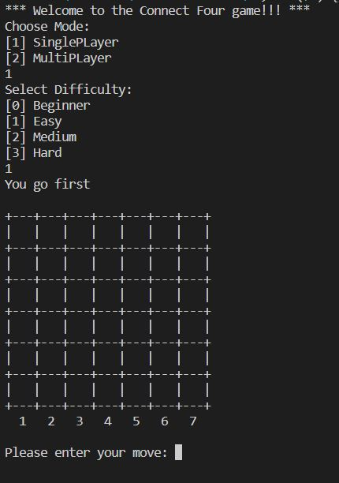
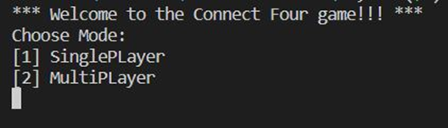
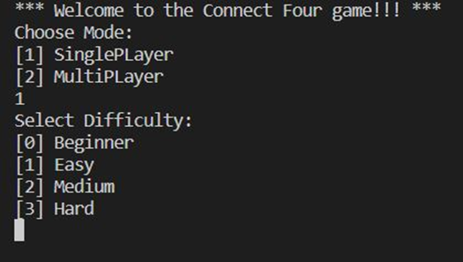
Single Player (Easy)
Initial board in any mode and in any difficulty, easy in this case

Slide 9
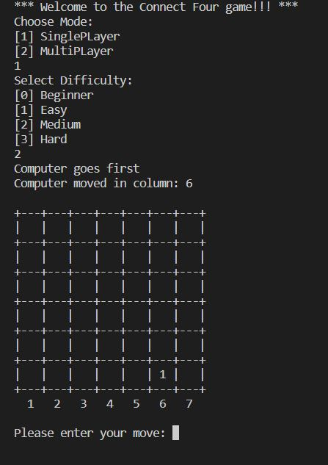
Single Player (Medium)
Initial board in any mode and in any difficulty, medium in this case

Slide 10
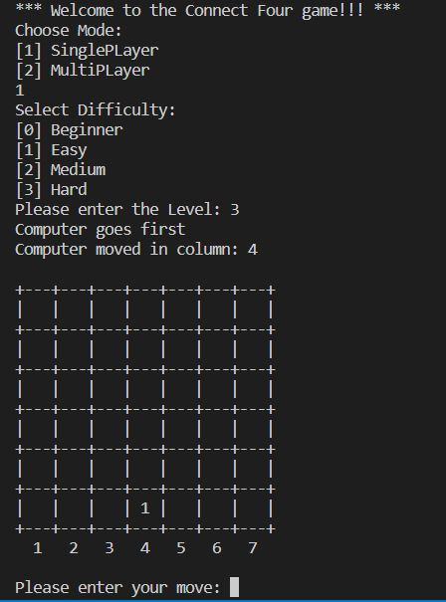
Single Player (Hard)
Initial board in any mode and in any difficulty, hard in this case

Slide 11
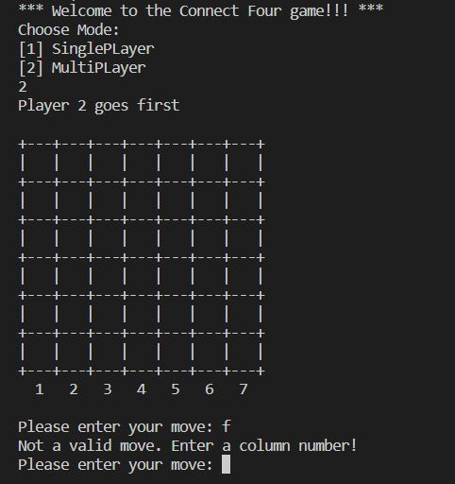
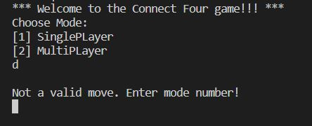
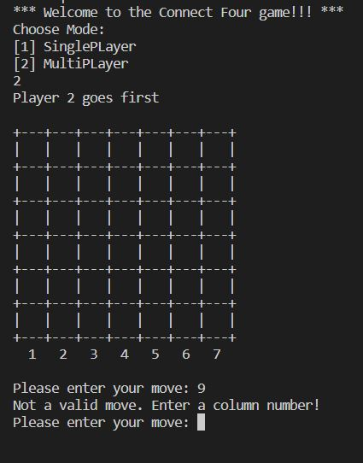
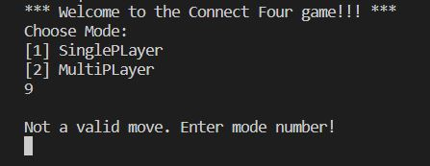
Tackling Bugs
Choosing a wrong game mode (1)
Choosing a wrong column number (2)
Choosing a wrong game mode (2)
Choosing a wrong column number (1)

Slide 12
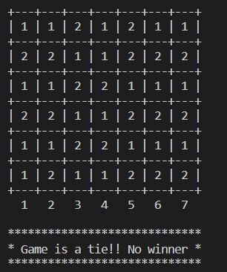
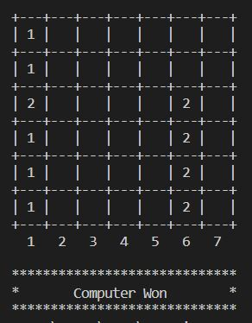
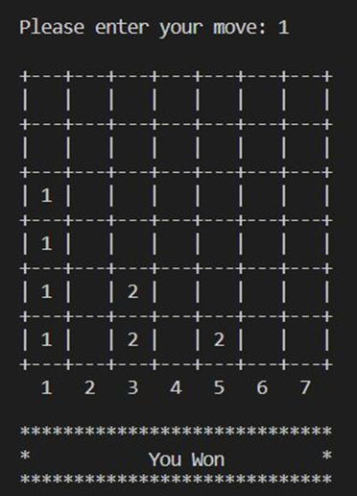
Game Ends, Either a Win or a Tie
Game is a tie (No winner, in this case)
Bot wins
Player wins vs bot (in multiplayer mode, the output specifies which player wins as well or if the game ends in a tie)

Slide 13
